Slide 1
PRESERVATION OF LAKE QUASSAPAUG
2014 COMMUNITY PRESENTATION

Slide 2
2012-2014 LAKE QUASSAPAUG STUDY
Background
Last complete study in 1989
Initial review of the lake by Greg Bugbee of the Connecticut Agricultural Station in summer 2011 with presentation in January 2012. Primary concerns were water quality and invasive weeds.
Establishment of Lake Quassapaug Association in 2012-2013
Representative of watershed homeowners, organizations, Town of Middlebury, including Tylers Cove Assn, West Shore Assn., Quassy, Sportsmens Club, Land Trusts and others.

Slide 3
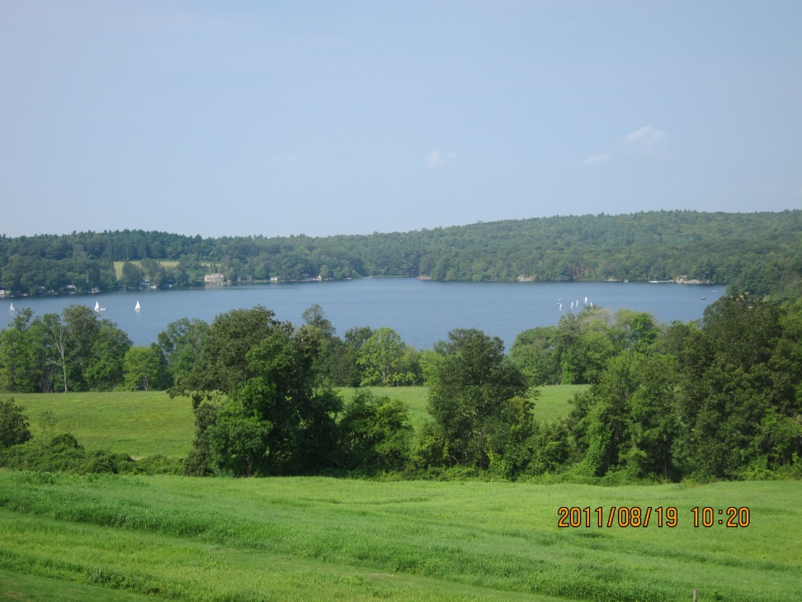
2012-2014 Lake Quassapaug Study
Current Study and Actions
Board of LQA hired consultant George Knoecklein to carry out year long study of water quality and plant inventory.
Board reviewed both recent studies, information from other CT lakes, national lake studies and data on invasive weed management.

Slide 4
2012-2014 LAKE QUASSAPAUG STUDY
Board held extensive discussions on lake management issues with outreach to address concerns of different interests on the lake.
Board approved hand pulling of Eurasion milfoil in Dam Cove during fall 2013.

Slide 5
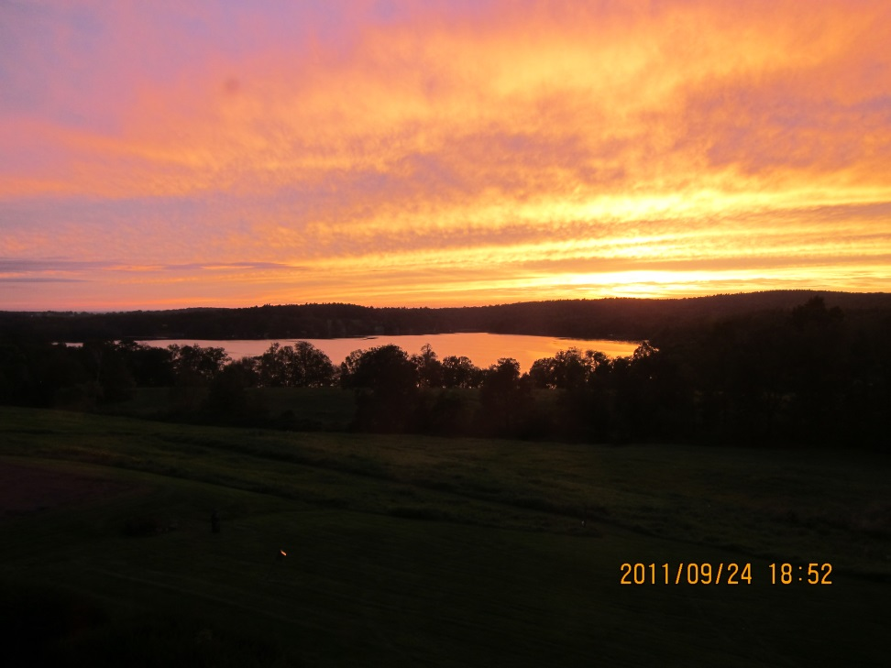
2014 Lake Quassapaug Assn Actions
Water Quality
Water quality will be gathered for 7-8 months in 2014 with a written report on the findings provided by George Knoecklein by the end of 2014.

Slide 6
2014 Lake Quassapaug Assn Actions
Invasive Weed Management
Spread and density of invasive weeds has grown substantially in the last ten years.
Decision to undertake management was made only after lengthy data gathering and study.
Four major areas affected by milfoil: Big, Middle, Tylers and Dam Coves.

Slide 7
Invasive Weed Management
Initial treatment approved for Tylers Cove given the heavy infestation, number of homeowners affected by the infestation and amount of boat traffic that can further spread the milfoil. Eurasion milfoil in Middle Cove also to be addressed possibly through handpulling.
Monitoring and evaluation through plant survey and fish count to determine effectiveness and impact on environment.

Slide 8
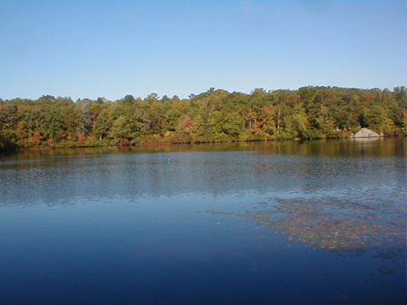
Invasive Weed Management
Treatment with a systemic herbicide selective for dicots - probably form of 2,4 D. Extent, timing and specific herbicide to be determined with application vendor.

Slide 9
Preventive Measures
As important as addressing the current invasive weed issues is a preventive effort to exclude other invasive weeds from Lake Quassapaug. Some of these invasives are more of a threat and more difficult to manage than the milfoil and can be found in many other CT lakes.
LQA has established an Invasive Weed Prevention Committee ( IWPC )that will study and make recommendations for education and action to limit introduction of other invasives into Lake Quassapaug.

Slide 10
Invasive Weed Prevention Committee Formed: 1/15/14
Alice Hallaran
Paul Anderson
Keith Goodson
Jack Starr

Slide 11
IWPC Action Plan:
1.) List all transient boat entry points
Establish the contact person
Estimate number of launches/yr.
2.) Install educational signage at these entry points.
3.)List area lakes and what they have put in place to monitor & control the re-introduction of invasive weeds.
4.) Develop a comprehensive boat inspection plan that will work for Lake Quassapaug.

Slide 12
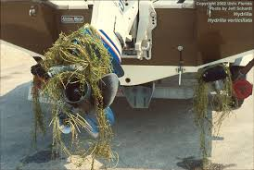
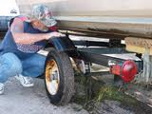
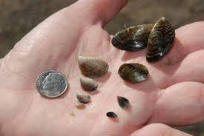
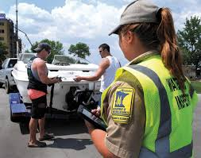
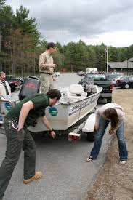
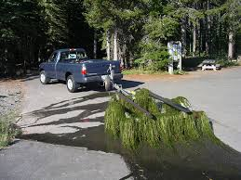

Slide 13
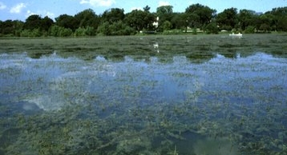
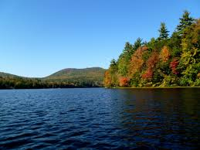

Slide 14
SUPPORT FOR LAKE QUASSAPAUG ASSOC.
Estimated 2014 budget for LQA is $16,000 to cover our consultant contracts, invasive weed treatment , prevention efforts and minimal administrative costs.
Invasive weed management is critical to every homeowner and organization in the lake watershed. Without your support, LQA cannot carry out its mission to preserve Lake Quassapaug. Our thanks to so many of you who supported us in the last two years to establish the association.

Slide 15
SUPPORT FOR LAKE QUASSAPAUG ASSOC.
Please continue your membership or become a new member of LQA. Middlebury Land Trust will match every new member’s dues up to $2500.
Dues for individual homeowners remain at $100/household, but we will need additional contributions to achieve our $16,000 budget.

Slide 16
SUPPORT FOR LAKE QUASSAPAUG ASSOC.
Membership applications are available as you leave.
T- shirts - $20.00 ea. Hats - $20.00 ea.
Thank you for your support!
Lake Quassapaug Association Board of Directors

