Slide 1
Lake Quassapaug Summary Report
December 15, 2016

Slide 2
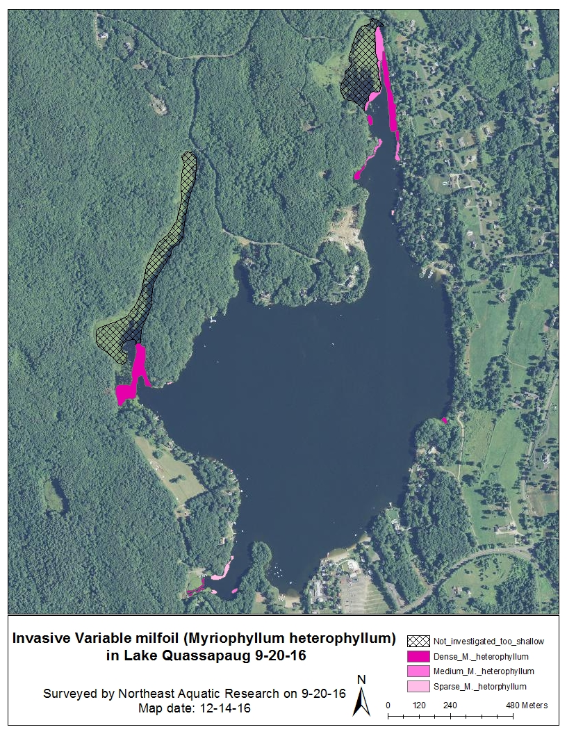
Distribution of Variable milfoil in Lake Quassapaug during survey conducted on September 20, 2016
Approximately 7.8 acres
Dense = 5.25
Medium = 1.93
Sparse = 0.59

Slide 3
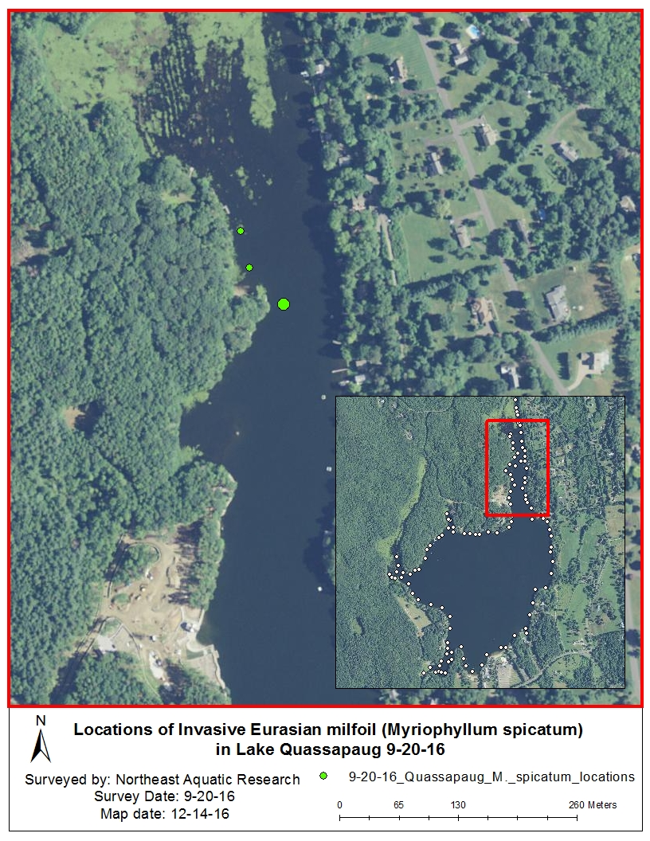
Locations of Eurasian Milfoil in Lake Quassapaug during survey conducted on September 20, 2016

Slide 4
Phosphorus Results values reported as ppb
Lake Samples
depths | 4/20/2016 | depths | 5/10/2016 | depths | 7/5/2016 | 8/18/2016
1m | 6 | 1m | 14 | 1 | 11 | 9
8m | 11 | 4m | 13 | 2 | 10 | 12
14m | 9 | 10m | 10 | 3 | 18 | 14
 |  | 15m | 9 | 4 | 16 | 159
Storm water samples
 | 5/3/2016
End of Tyler cove | 2
Tyler's Cove Road | 435
North end of Big Cove | 14

Slide 5
Secchi disk Water Clarity reported in meters
April 28, 2016 7.5m
May 10, 2016 6.0m
August 5, 2016 7.5m
August 18, 2016 7.5m

